Slide 1

CHINOOK MUSIC STORE ANALYSIS
Lokesh Reddy Chiluka
09-03-2026

Slide 2
Agenda
Introduction & Objective
Data Overview & Quality Check
Sales Analysis: Top Tracks, Artists, Genres
Global vs. USA Sales Trends
Customer Demographics
Purchase Behaviour & Churn
Revenue by Country & Region
Album Promotion Recommendations
Customer Segmentation & CLV
Business Insights
Conclusion & Recommendations

Slide 3
Problem Statement
Ensure data integrity by identifying and handling missing values and duplicates.
Discover top-selling tracks, artists, and genres in both USA and global markets.
Analyze customer demographics and purchasing behavior, including churn rate and frequency.
Calculate total revenue and identify top customers by geographic region.
Recommend albums for promotion based on genre sales and customer interests.
Segment customers by purchase history to predict lifetime value and detect high-risk groups.

Slide 4






Dataset & Tools
Chinook MySQL database
Tools used: MySQL Workbench, Excel, Pivot Tables, PowerPoint
Tables used: Customers, Invoice, Invoice Line, Tracks, Artists, Albums, Genres, Employee, Playlist, Playlist track, Media Type.

Slide 5
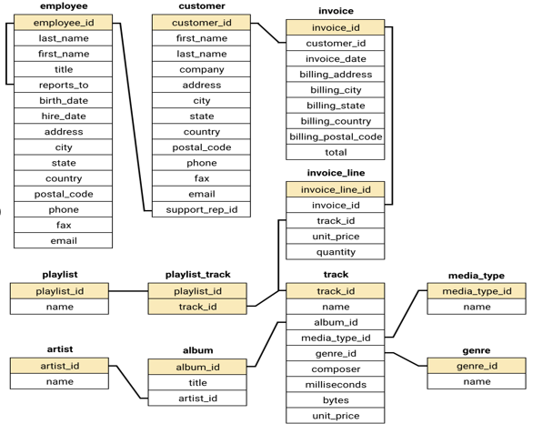
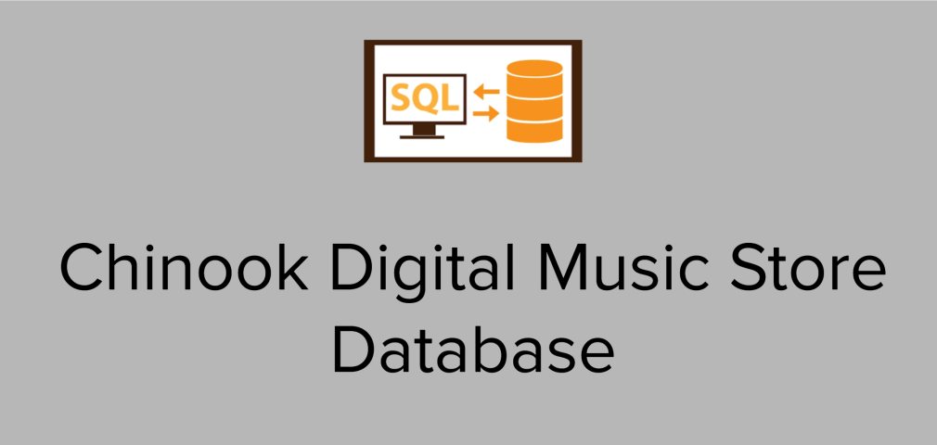
Database Schema

Slide 6
Data Quality Check
Missing values (example: NULL in state)
Identify and address missing values and duplicates to ensure data integrity.
Handled duplicates and nulls
Ensured relational integrity across joins
Checked for NULLs and duplicates in key tables like customer, track, and invoice.
Found no critical missing values in customer names or invoice totals.
Minor duplicates found in track names but tied to different albums/artists.
No orphaned records detected (foreign key integrity intact).
Overall, the database is clean and reliable for analysis.

Slide 7
Total Revenue and Invoice Count by Region
Revenue and invoice data was grouped by billing country, state, and city using the invoice table.
Czech Republic (Prague) generated the highest revenue at $273.24 from 30 invoices.
Other top-performing cities include Mountain View (USA) and London (UK).
Notable European markets like Berlin, Paris, and Dublin also show strong revenue.
This breakdown helps identify geographic hotspots for physical music sales and strategic market expansion.
Custom Combination Chart

Slide 8
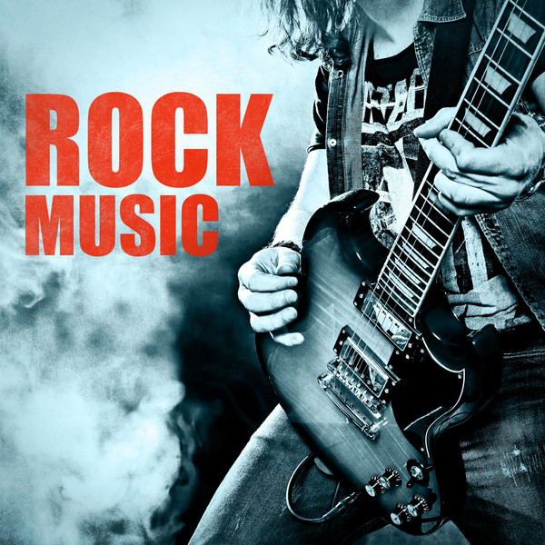
Top-Selling Tracks, Artists & Genres
Insights:
Genre Popularity: Rock is the dominant genre with the highest total sales figures. The top three albums all belong to this genre, indicating a strong market preference for Rock music in the USA.
Sales Figures: The selected albums have the highest total genre sales, making them strong candidates for promotion.
Given the strong sales performance of these albums in the Rock genre, they should be prioritized for advertising and promotion in the USA to capitalize on their popularity.

Slide 9
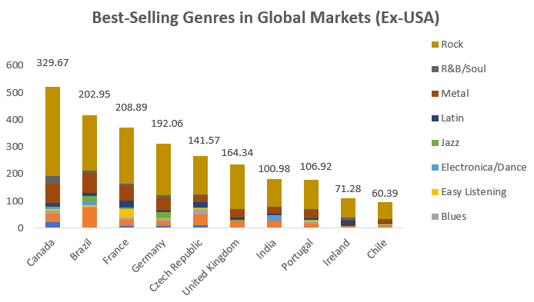
Commonalities:
Rock dominates in almost all the countries listed, indicating a strong global preference for Rock music outside the USA.
Metal and Alternative & Punk are also popular in Brazil, showing a more diverse taste in music genres in that country.
Rock is the top genre in every country mentioned except for the specific instances where Metal or Alternative & Punk are highlighted.
Differences:
Brazil stands out with significant sales in both Alternative & Punk and Metal genres, in addition to Rock, showing a more varied musical taste compared to other countries.
Metal has a notable presence in Canada and Brazil but does not appear as a top genre in other countries listed.
The sales volume for genres other than Rock is generally lower in all non-USA countries, indicating Rock’s dominance.
Comparison with the USA market

Slide 10
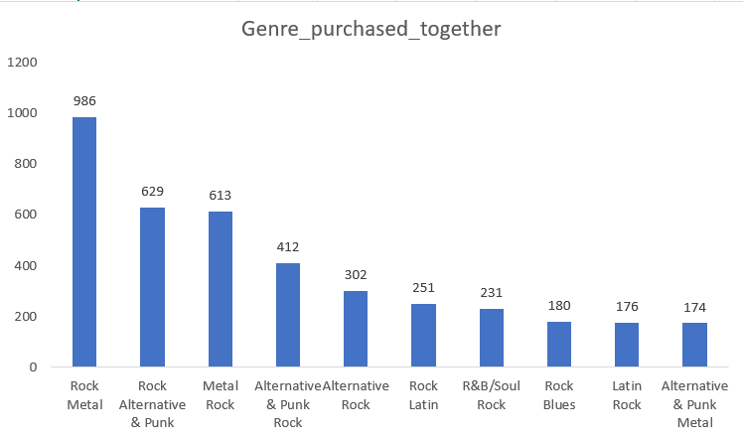
Genre Purchased Together
Insights:
Metal and Rock are the most frequently purchased together, indicating a strong overlap in fan base.
Alternative & Punk and Rock also show significant co-purchase rates, suggesting shared listener preferences.
Latin and R&B/Soul genres have notable pairings with Rock, pointing to potential opportunities for cross-genre promotions.
Recommendations:
Bundle Offers: Combine Metal and Rock albums, along with Alternative & Punk with Rock for popular bundles.
Cross-Promotions: Promote Metal albums to Rock fans and vice versa, leveraging their shared appeal.

Slide 11
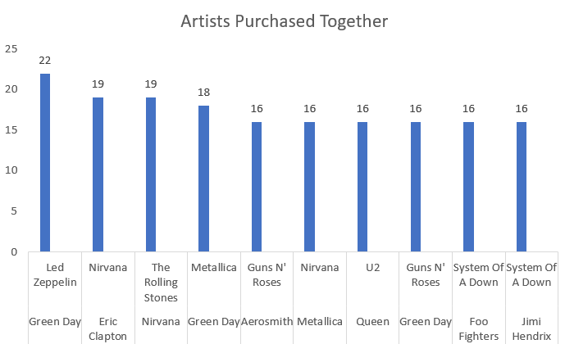
Artists Purchased Together
Insights:
Green Day and Led Zeppelin are frequently purchased together, indicating strong cross-genre appeal.
Nirvana and The Rolling Stones, as well as Eric Clapton and Nirvana, show notable co-purchase patterns, suggesting these artist pairings resonate with similar audiences.
Artists like System Of A Down and Foo Fighters, and Queen and The Police, also have significant co-purchases, highlighting popular combinations among listeners.
Recommendations:
Artist Pairing Promotions: Offer discounts on Green Day and Led Zeppelin albums purchased together and apply similar deals to pairings like Eric Clapton and Nirvana.
Playlist Curation: Create playlists featuring frequently paired artists to appeal to similar tastes.

Slide 12
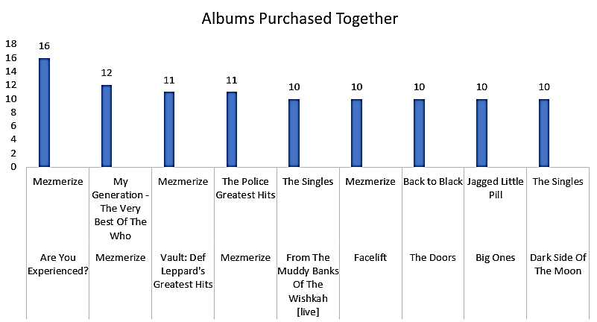
Albums Purchased Together
Insights:
"Mezmerize" is a popular album paired with several others, including "Are You Experienced?" and "The Police Greatest Hits," indicating it resonates well with fans of diverse classic rock albums.
Albums like "The Police Greatest Hits" and "My Generation - The Very Best Of The Who" frequently appear together, suggesting a strong preference for classic rock compilations.
"Big Ones" and "Back to Black" also show notable co-purchase rates, highlighting popular cross-genre interests among listeners.
Album Pair Deals: Offer combined deals on album pairs like "Are You Experienced?" and "Mezmerize."
Special Editions: Create box sets with frequently paired albums to attract collectors.

Slide 13
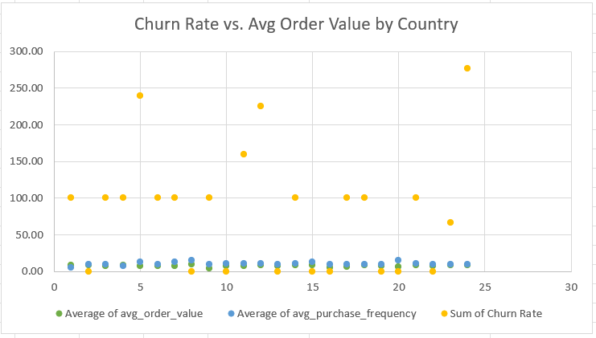
Comparing Churn Rate with Average Order value by Country
Churn Rates:
High Churn Regions: São José dos Campos, Montréal, São Paulo, Rio de Janeiro, Brasília, Edmonton, Mountain View, and Redmond.
Insight: High churn suggests a need for better customer retention strategies, such as loyalty programs and enhanced support.
Correlation with Local Factors:
Affluent Areas: High spending and frequency suggest higher income and better economic conditions.
Emerging Markets: Moderate spending with high frequency points to budget-conscious middle-class consumers.
High Churn in Competitive Areas: Competition and high living costs may affect loyalty.
Scatter plot graph
Recommendations:
High-Value Areas: Offer exclusive products and premium pricing.
Moderate Areas: Enhance engagement with loyalty programs and value offers.
High Churn Areas: Address churn with discounts, improved service, and feedback collection.

Slide 14
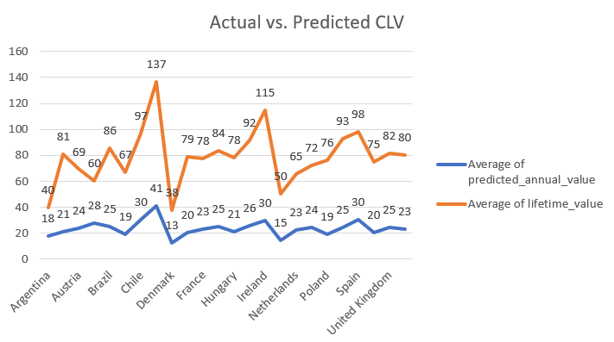
Analyzing Customer Life-Time Value(CLV) by comparing actual vs Predicted CLV with line graph.
Identifying churn patterns and characteristics helps in creating effective retention strategies, enhancing customer loyalty, and reducing churn.
Insights:
Customer Segments and Predicted Lifetime Value:
High Lifetime Value Customers: Example: František Wichterlová from Prague. High spending and average order value. Need targeted retention strategies.
Low Lifetime Value Customers: Example: Mark Philips from Edmonton. Lower spending and order values. More price-sensitive or less engaged.
Observed Purchase Patterns:
Higher Engagement: Frequent purchases reduce churn risk.
Lower Order Value: Customers with low average order values but long tenure may be at risk if they don’t perceive value.

Slide 15
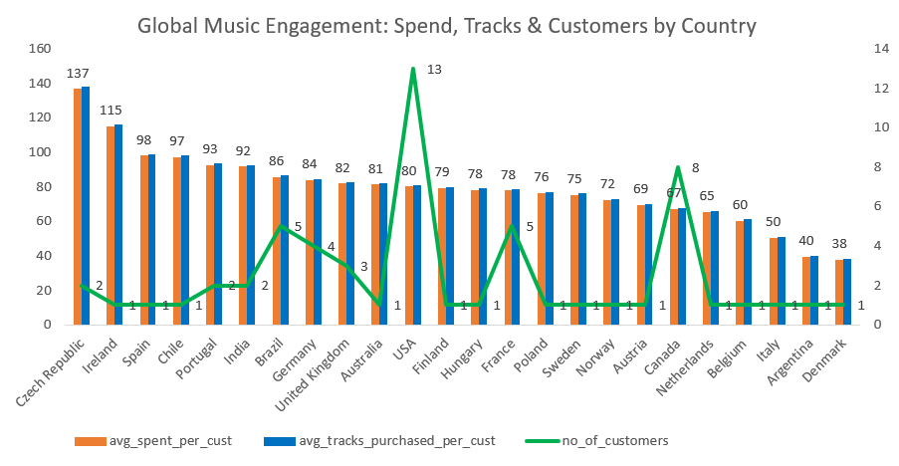
Insights:
The Czech Republic has the highest average amount spent per customer at $136.62, indicating high customer value in this region.
The USA has the largest customer base with 13 customers but a lower average spend of $80.04, suggesting a broad but less intense engagement.
Customers from India, Portugal, and Brazil show moderate average spending, ranging from $85.54 to $92.57, with varied customer bases.
Countries like Argentina and Denmark have the lowest average spend per customer, around $40, reflecting limited purchasing activity.
Countries with only one customer, like Ireland and Spain, have relatively high average spends, highlighting significant individual contributions.

Slide 16
Conclusion & Strategic Recommendations
Rock is the highest-grossing genre globally and in the USA.
Long-term customers contribute significantly more to revenue than short-term ones.
High churn detected in several low-engagement countries.
Top customers are concentrated in a few key markets (e.g., Czech Republic, Ireland).
Recommendations
Focus promotions on top-selling albums in Rock, Alternative & Metal genres.
Re-engage churned customers through targeted campaigns in high-churn countries.
Prioritize long-term customer retention through loyalty rewards and personalized offers.
Monitor CLV and churn trends monthly to proactively target at-risk segments.
“Data-driven strategies can maximize sales and enhance customer loyalty for Chinook.”

Slide 17
THANK YOUnk You

